Slide 1

Application Layer
Computer Networking: A Top Down Approach,
Jim Kurose, Keith Ross
Addison-Wesley.

Slide 2
Beberapa Aplikasi Jaringan
e-mail
web
Instant messaging (online Chat)
Remote login (akses host dalam jaringan)
P2P file sharing
multi-user network games
streaming stored video clips
voice over IP (VOIP): percakapan suara jarak jauh melalui media internet
real-time video conferencing
grid computing
…

Slide 3





Creating a network app
application
transport
network
data link
physical
Application programs
  Bekerja pada end systems
  Berkomunikasi melalui jaringan
application
transport
network
data link
physical
application
transport
network
data link
physical

Slide 4
Application architectures
Client-server
Peer-to-peer (P2P)
Hybrid of client-server and P2P
2: Application Layer

Slide 5
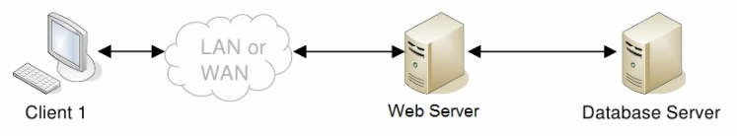
Client-server architecture
server:
  Selalu menjadi host
  permanent IP address
Clients (in general):
  communicate with server
  have dynamic IP addresses
  Tidak berkomunikasi langsung dengan yang lain
2: Application Layer

Slide 6
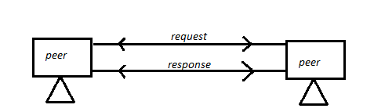
Pure P2P architecture
Tidak menggunakan server
End system berkomunikasi secara langsung
example: Gnutella (protokol berbagi data atau file sharing )
Sangat skalabel tapi sulit untuk di manage

Slide 7
Hybrid of client-server and P2P
Skype
  Aplikasi P2P voice-over-IP
  Server terpusat: finding address of remote party
  Koneksi antar client: direct (tidak melalui server)
Instant messaging
  chatting between two users is using P2P
  centralized service: client detection & location
    user registers IP address with central server
    uses central server to find addresses of buddies (alamat teman)
2: Application Layer

Slide 8
Web and HTTP
2: Application Layer

Slide 9
HTTP overview
HTTP: hypertext transfer protocol
client/server model
  client: browser to request & receive Web objects
  server: Web server sends objects in response to requests
HTTP dapat mengirimkan berbagai jenis data
HTTP 1.0
HTTP 1.1
HTTP request
PC running
Explorer
HTTP response
HTTP request
Server
running
Apache Web
server
HTTP response
Mac running
FireFox
2: Application Layer

Slide 10
HTTP overview (continued)
Uses TCP:
Client memulai koneksi TCP ke server, port 80
Server accepts TCP connection from client
Saling tukar pesan antara HTTP client and HTTP server
TCP connection closed
2: Application Layer

Slide 11
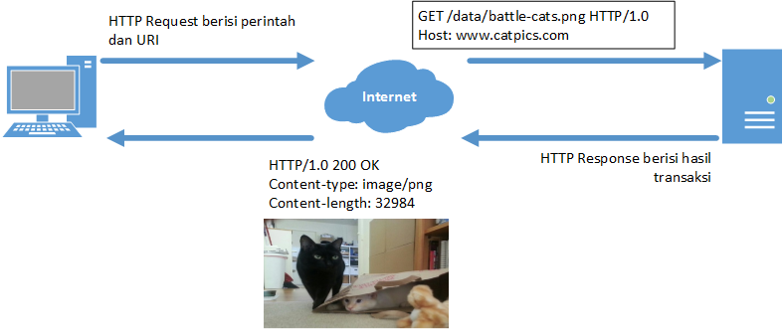
Transaksi HTTP
2: Application Layer

Slide 12
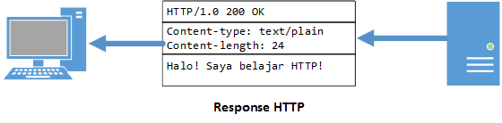
Pesan HTTP
Pesan berupa request atau response
Bagian dari pesan:
  Start line
  Header
  Body: Data yg ingin dikirimkan
2: Application Layer

Slide 13
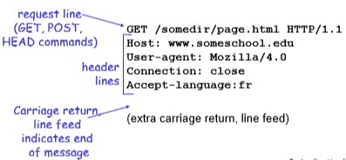
Sintaks Pesan HTTP
Pesan Request
<method> <request-URL> <version>
<headers>
<Body>
<entity-body>
Contoh:
method: aksi yang ingin client minta, misal: GET, POST
Request-URL: Lokasi data yang diminta cient.
Version: Versi HTTP yang digunakan oleh pengirim
Header: nol atau lebih header, dengan format:
  <nama-header>: <isi-header><CRLF>
  <nama-header>: <isi-header><CRLF>
  ...
  <CRLF>
- Isi dari pesan

Slide 14
Contoh start Line request
GET /test/hello.txt HTTP/1.1
Ket:
- GET: Method (Operasi yang diminta)
- Jenis method:
-GET: Ambil dokumen dari server
-HEAD: Ambil header dokumen dari server
-POST: Kirimkan data ke server untuk diproses
-PUT: Simpan data yg ada dibagian Body ke server
-TRACE: Ikuti jejak pesan dari proxy server sampai server
- OPTIONS: temukan method apa saja yg dapat dijalankan oleh server
-DELETE: hapus data dari server
2: Application Layer

Slide 15
Contoh start Line request
GET /test/hello.txt HTTP/1.1
Ket:
/test/hello.txt : lokasi data pada server
2: Application Layer

Slide 16
Contoh start Line request
GET /test/hello.txt HTTP/1.1
Ket:
HTTP/1.1 : Versi protokol yang digunakan oleh pengirim pesan.
HTTP/1.0
GET
POST
HEAD
HTTP/1.1
GET, POST, HEAD
PUT
DELETE
2: Application Layer

Slide 17
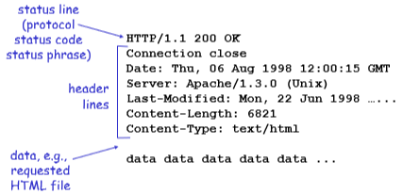
Sintaks Pesan HTTP
Pesan Respons
<version> <status> <reason-phrase>
<headers>
<entity-body>

Slide 18
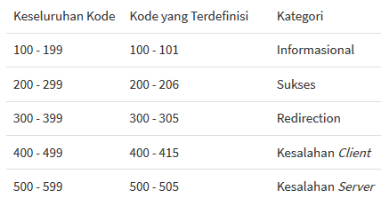
Contoh start Line Respon
HTTP/1.0 200 OK
Ket:
HTTP/1.0 : Versi protokol yang digunakan
200 OK: Status dari informasi yang diminta oleh pesan request
Kode Status
2: Application Layer

Slide 19
Contoh HTTP response status codes
200 OK
  request succeeded, requested object later in this message
301 Moved Permanently
  requested object moved, new location specified later in this message (Location:)
400 Bad Request
  request message tidak dipahami oleh server
404 Not Found
  request document tidak ditemukan server
505 HTTP Version Not Supported
2: Application Layer

Slide 20
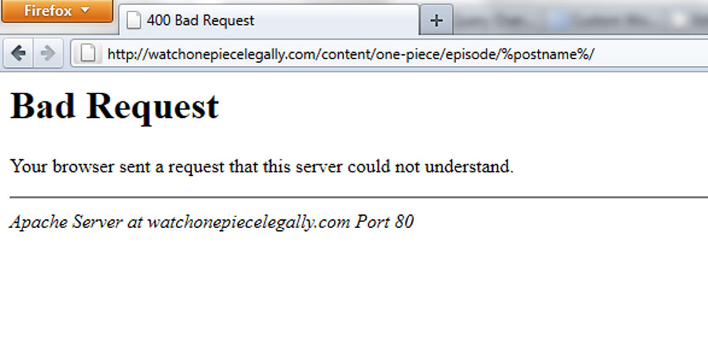
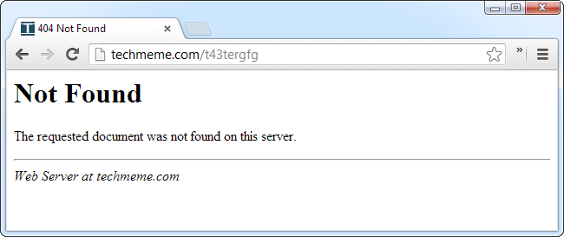
Contoh Respon Status Code
2: Application Layer

Slide 21
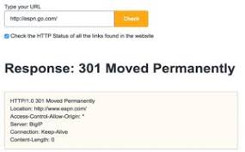
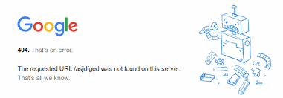
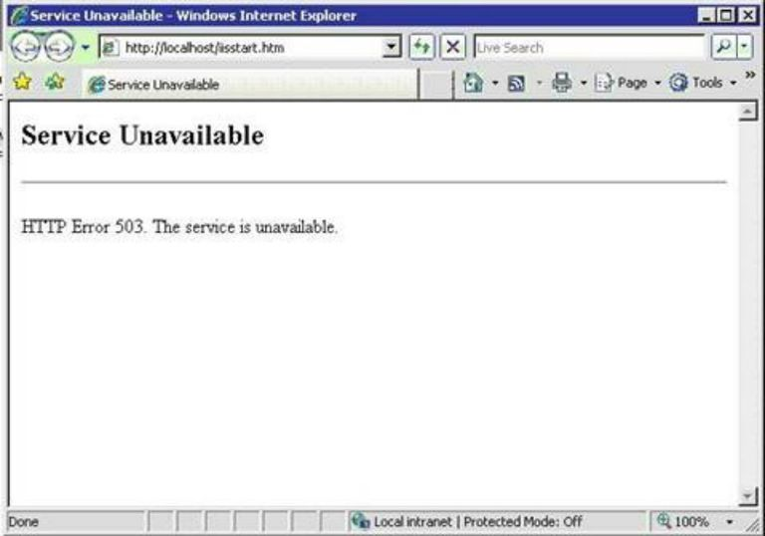
Contoh Respon Status Code
2: Application Layer

Slide 22
Header Pesan HTTP
Informasi tambahan pesan request dan respon
Daftar name dan value
Contoh:
-Content-length: 20
- Panjang konten 20
2: Application Layer

Slide 23
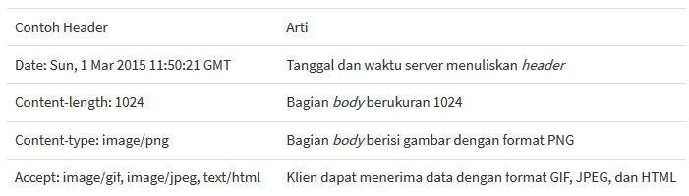
Contoh Header yang umum digunakan
2: Application Layer

Slide 24
HTTP connections
Nonpersistent HTTP
Paling banyak satu objek dikirim melalui koneksi TCP.
Digunakan pada HTTP/1.0
II. Persistent HTTP
Beberapa objek dapat dikirimkan melalui koneksi TCP tunggal
Digunakan dalam HTTP/1.1
2: Application Layer

Slide 25
I. Nonpersistent HTTP
(contains text,
references to 10
jpeg images)
User enters URL someSchool.edu/someDepartment/home.index
1a. HTTP client initiates TCP connection to someSchool.edu : port 80
1b. HTTP server @ someSchool.edu port 80. “accepts” connection, notifying client
2. HTTP client sends request message (containing URL) into TCP connection. Message indicates that client wants object someDepartment/home.index
3. HTTP server receives request message, sends response message containing requested object
time
2: Application Layer

Slide 26
I. Non-Persistent HTTP: Response time
Definition of RTT: time to send request from client to server and back.
Response time:
one RTT to initiate TCP connection
one RTT for HTTP request and first few bytes of HTTP response to return
file transmission time
total = 2RTT+transmit time
initiate TCP
connection
RTT
request
file
RTT
time to
transmit
file
file
received
time
time
2: Application Layer

Slide 27
I. Nonpersistent HTTP (cont.)
4. HTTP server closes TCP connection.
5. HTTP client receives response message containing html file, displays html. Parsing html file, finds 10 referenced jpeg objects
time
6. Steps 1-5 repeated for each of 10 jpeg objects
2: Application Layer

Slide 28
Persistent HTTP
I. Nonpersistent HTTP issues:
requires 2 RTTs per object
OS overhead for each TCP connection
browsers often open parallel TCP connections to fetch referenced objects
II. Persistent HTTP
server leaves connection open after sending response
subsequent HTTP messages between same client/server sent over open connection
A. Persistent without pipelining:
client issues new request only when previous response has been received
one RTT for each referenced object
B. Persistent with pipelining:
default in HTTP/1.1
client sends requests as soon as it encounters a referenced object
as little as one RTT for all the referenced objects
2: Application Layer

Slide 29
Application layer
(Materi Lain)
FTP
Electronic Mail
  SMTP, POP3, IMAP
DNS
SNMP
USENET NEWS
P2P Applications
2: Application Layer

